Slide 1
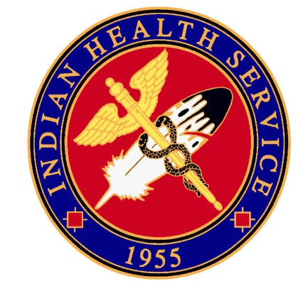
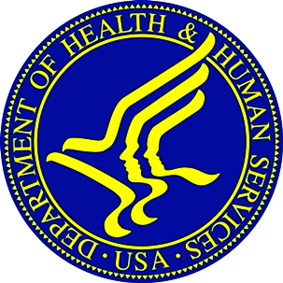
Indian Health Service
Portland Area Director’s Update
Dean M Seyler - Area Director
January 24, 2013
Quarterly Board Meeting
Wild Horse Casino Resort

Slide 2
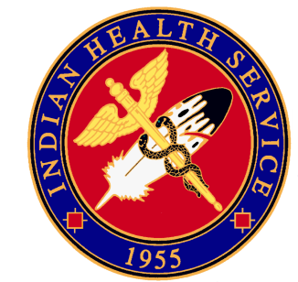

Renew And Strengthen Our Partnership With Tribes
2013 DHHS Regional Tribal Consultation
  Information Coming Soon
CHS Meeting Rescheduled
  February 20th and 21st
  Sheraton Denver Downtown
Title 1 Agreement Obligations
  Annual Performance Reporting

Slide 3
Renew And Strengthen Our Partnership With Tribes
ARRA Wrap Up
Portland Area learned in December that it was the “first” in several regards.
  First of the 12 IHS Areas to obligate an ARRA project fund.
  First of the 12 IHS Areas to have an ARRA project constructed.
  First of the 12 IHS Areas to complete and administratively close-out its ARRA projects.
This occurred because of the strength of partnership between NW Tribes and IHS

Slide 4
To Reform The IHS
Chief Medical Officer Vacancy – Acting
USPHS Commissioned Corps Award Board
Recognition Of Excellence
HQ Oversight Review – May 2012

Slide 5
Improve The Quality Of And Access To Care
VA IHS National Reimbursement Agreement
      Signed on December 5, 2012
      Reimbursement for direct care services IHS provides to AIAN veterans
      Reimbursement based on VA eligibility
      No copays for veterans if services reimbursed
      Bill the VA after other third parties
      OMB All-inclusive rate for outpatient services
      Start with 10 federal programs, expand after 6 months
      Tribally managed programs can use this agreement
Have No Fear ICD10 Is Here- CM Training

Slide 6
Improve The Quality Of And Access To Care
Customer Service
Improving Patient Care (IPC)
  Patient centered medical home
Have No Fear ICD10 Is Here- CM Training
  Peggy L. Ollgaard
  Portland Area Indian Health Service
  503.414.5598 – Office
  Peggy.Ollgaard@ihs.gov

Slide 7
Ensure that our work is transparent, accountable, fair, and inclusive
IHS Budget Breakdown
December 19, 2012 DTL From Dr. Roubideaux
  Agency
  Area

Slide 8
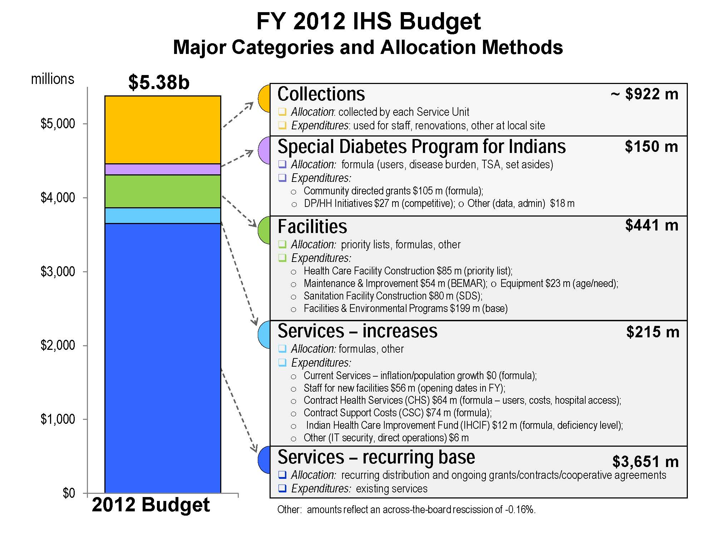
Ensure that our work is transparent, accountable, fair, and inclusive

Slide 10
Questions or Comments?
Our Mission... to raise the physical, mental, social, and spiritual health of American Indians and Alaska Natives to the highest level.
Our Goal... to assure that comprehensive, culturally acceptable personal and public health services are available and accessible to American Indian and Alaska Native people.
Our Foundation... to uphold the Federal Government's obligation to promote healthy American Indian and Alaska Native people, communities, and cultures and to honor and protect the inherent sovereign rights of Tribes.

Slide 11
Portland Area
User Population Numbers
Steven Poitra – Area Statistical Officer

Slide 12
FY12 User Population
Quick Stats:
  PAIHS service population is approximately 190,000*
  FY12 User Population was 109,705
    FY11 was 108,118
  Nearly one million patient visits in FY12 (938,342)
  *As of 2009, most recent data available, IHS publication: Trends in Indian Health. Service population is not AI/AN census population.

Slide 13
FY12 User Population
 | User Pop FY 2011 | User Pop FY 2012 |  | User Pop FY 2011 | User Pop FY 2012
Burns Paiute | 215 | 207 | Port Gamble | 1,531 | 1,609
Chehalis | 1,245 | 1,159 | Puyallup | 7,773 | 7,042
Coeur d’Alene | 5,014 | 4,990 | Quileute | 674 | 725
Colville | 8,384 | 8,481 | Quinault | 2,511 | 2,605
Coos, Lower Umpqua, Siuslaw | 778 | 722 | Samish | 593 | 710
Coquille | 1,163 | 1,107 | Sauk-Suiattle | 48 | 37
Cow Creek | 2,580 | 2,448 | Shoalwater Bay | 419 | 417
Cowlitz | 2,422 | 3,190 | Shoshone Bannock | 6,271 | 6,312
Grand Ronde | 3,703 | 3,948 | Siletz | 5,207 | 5,275
Hoh | 30 | 26 | Skokomish | 853 | 832
Jamestown S’klallam | 509* | 204 | Snoqualmie | 249 | 412
Kalispel | 554* | 565 | Spokane | 1,628 | 1,681
Klamath | 2,520 | 2,950 | Squaxin Island | 795 | 743
Kootenai | 183 | 182 | Stillaguamish | 125 | 107
Lower Elwha | 856 | 888 | Suquamish | 542 | 558
Lummi | 4,361 | 4,305 | Swinomish | 1,233 | 1,288
Makah | 2,244 | 2,304 | Tulalip | 5,021 | 5,023
Muckleshoot | 4,402 | 4,857 | Umatilla | 3,066 | 3,052
Nez Perce | 3,971 | 3,974 | Upper Skagit | 517 | 506
Nisqually | 1,715 | 1,872 | Warm Springs | 5,669 | 5,643
Nooksack | 1,086 | 1,190 | Western Oregon Service Unit | 2,790 | 2,661
NW Band of Shoshoni | 39 | 36 | Yakama | 12,629 | 12,862

